Slide 1
NatInvest: Center for Biodiversity Finance and Natural Capital
Director: Dr. Rodrigo Arriagada
Directora alterna: Dr. Alejandra Stehr
Instituciones participantes
PUC, U Concepción, U Los Andes, U del Desarrollo, U Adolfo Ibáñez

Slide 3
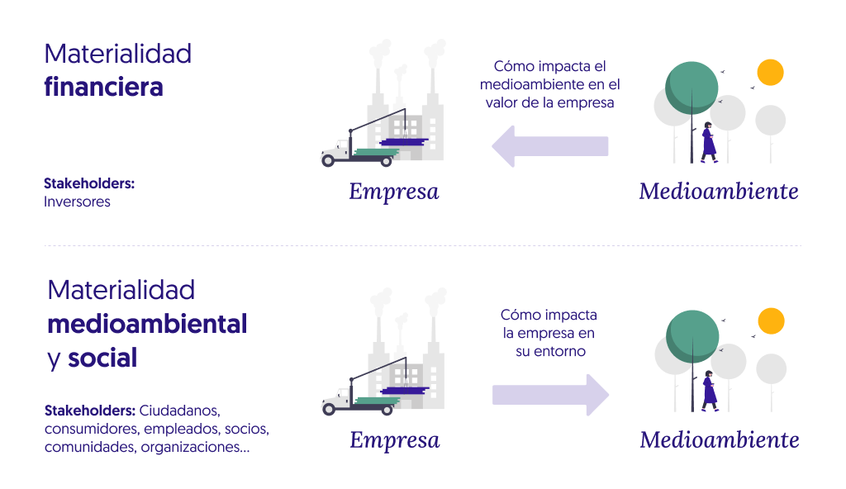

Slide 4
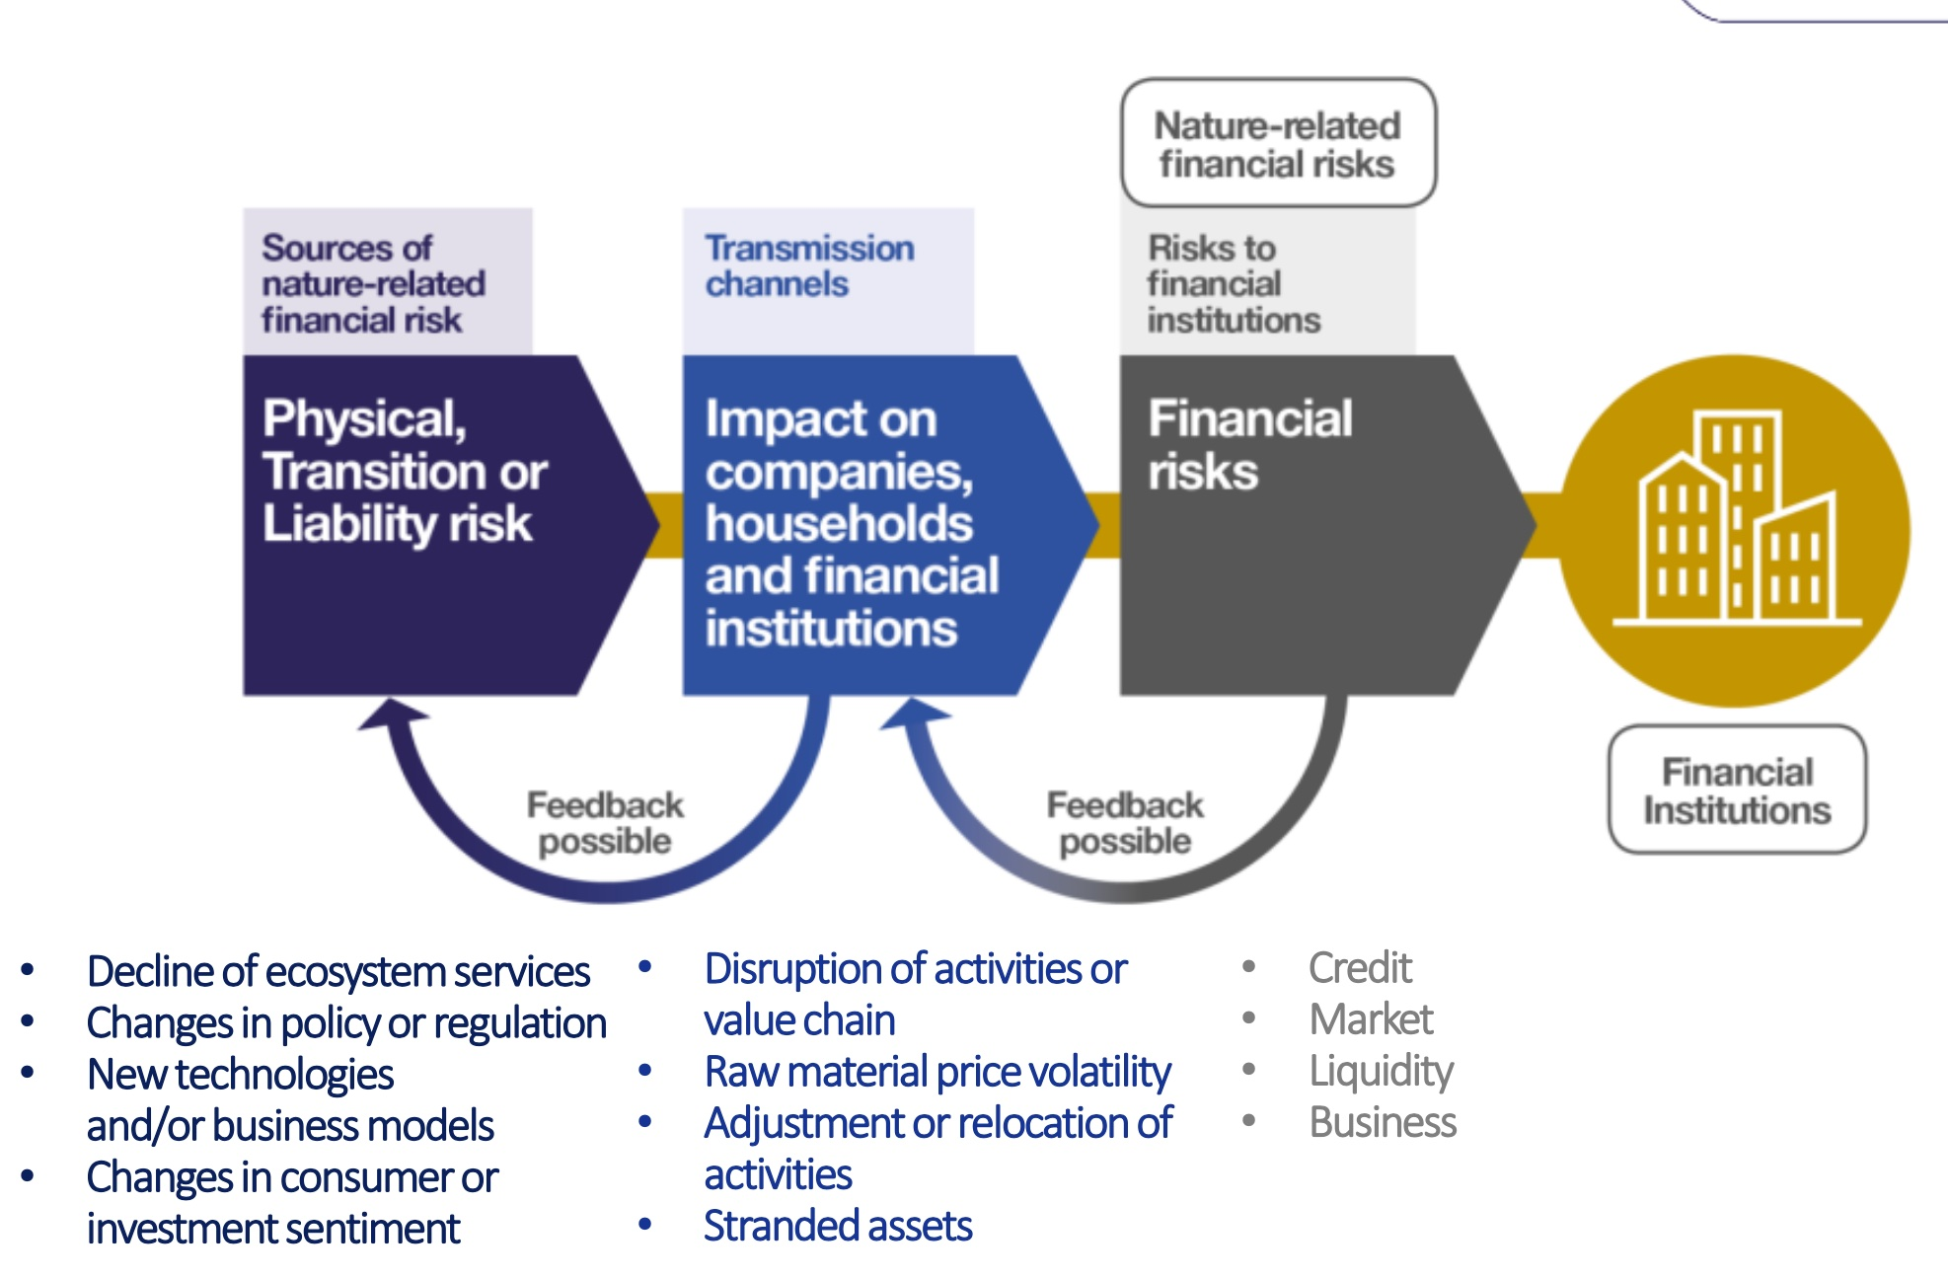

Slide 5
Biodiversity and financial risk
Loss of biodiversity and ecosystem services pose macroeconomic and financial risks and could result in economic shocks.
Policy makers, central banks, financial supervisors, market participants and other stakeholders are starting to recognize the risks biodiversity loss and degradation poses to economic activities and financial systems.
Kunming-Montreal Global Biodiversity Framework include Target 15 that calls on governments to take measures “to encourage and enable business [to] regularly monitor, assess and transparently disclose their risks, dependencies and impacts on biodiversity”.
Substantial literature exists on the economic value of biodiversity and natural capital and the services they provide, but the literature on the economic and financial risks associated with biodiversity loss and the degradation of ecosystem services is more nascent, particularly in terms of firm- or sector-level performance.

Slide 6
Measuring nature-related financial risks
Transmission of nature-related risks remains a complex issue. Models to analyze dependence on biodiversity and natural capital, and how these systems impact nature and biodiversity through its use are limited.
It is difficult to quantify impacts and dependencies of biodiversity loss on the provision of ecosystem services, and of these on productive activities.
There is no common homogeneous definition of impacts and dependences, or defined variables and criteria used to define and calculate them.
An analysis of the ecosystem services on which the economy and financial sector depend are still developing, and this results in a lack of a comprehensive understanding about the interaction between ecosystem services and the economic and financial sectors.

Slide 7
Aim and objetives:
To enhance the integration of financial risk assessment concerning natural capital and biodiversity, thereby offering solutions to stakeholders to incorporate nature into their business.
Specific objectives:
To provide quality-assured, relevant, scientifically robust, traceable data and analytics on natural capital measurements and valuation.
To understand and describe the dependencies and impacts between biodiversity and ecosystem services and key economics sectors including mining, forestry and water for human consumption.
To develop a methodological framework to translate biodiversity risks into financial risks (key metrics and indicators, measurement approaches, tools and practices, impacts and dependencies in the financial sector).
To co-design, implement and scale up investable water-related NbS to protect, sustainably manage and restore natural and modified ecosystems.

Slide 8
Research lines
Research line 1: Natural capital measurement (PI: Pablo Becerra, PhD)
Research line 2: Natural capital valuation (PI: Felipe Vásquez, PhD)
Research line 3: Analysis of dependencies and impacts between nature and key economic sectors (PI: Alejandra Engler, PhD)
Research line 4: Estimation of nature-related financial risks and market development (Pis: Viviana Fernández, PhD and Rodrigo Arriagada, PhD)
Research line 5: Design of nature-based solutions to promote private investment in biodiversity and ecosystem services (PI: Alejandra Stehr, PhD)
Notes:
Obj 3. indicadores,
NbS: definición
To design integrated methodologies to evaluate NbS
Existe demanda de inversionistas para invertir en empresas
La presión puede venir desde los inversionistas
Distinguir los distintos tipos de financiamieto. Eje. Donaciones, inversionistas, inversión con cierto retorno
Desafios de administradoras de fondos de pensión

Slide 9
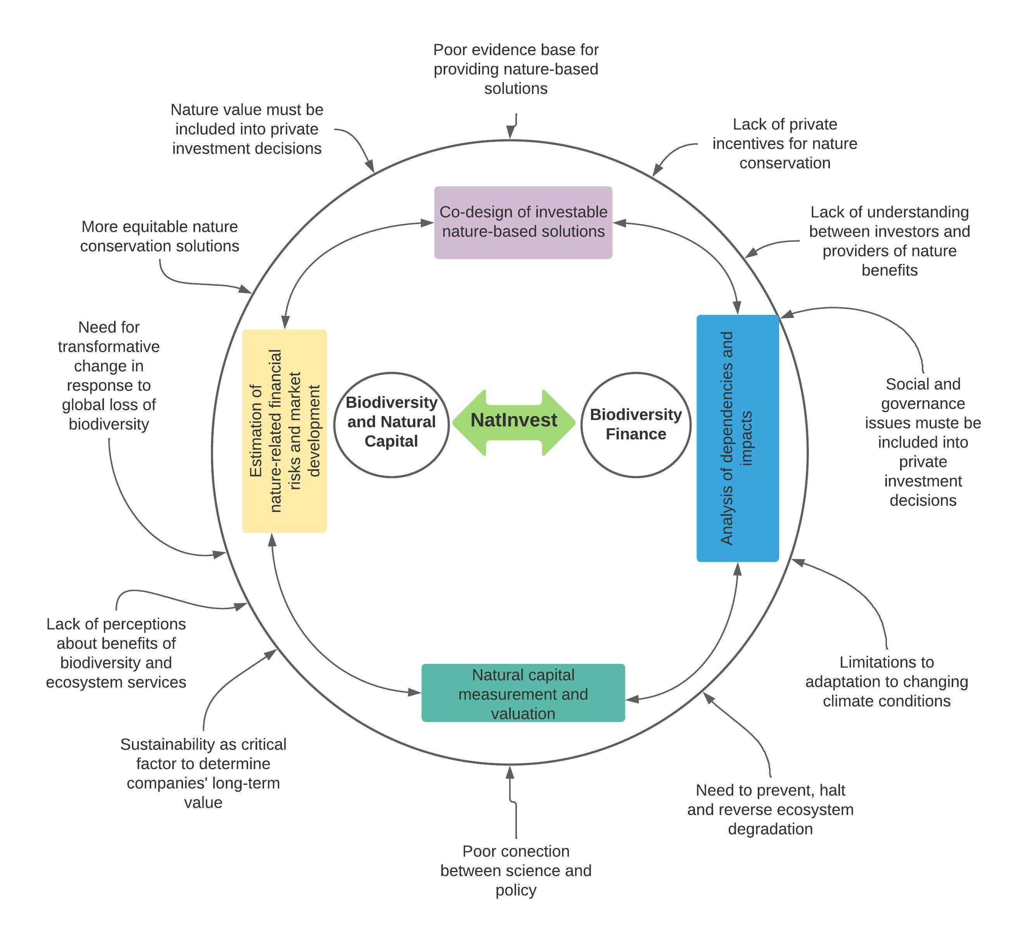

Slide 10
Anexos

Slide 13
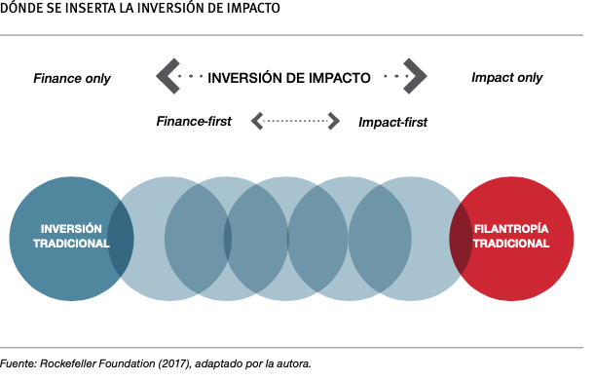
ESG Inversión: Environment, Social and Governance

Slide 14
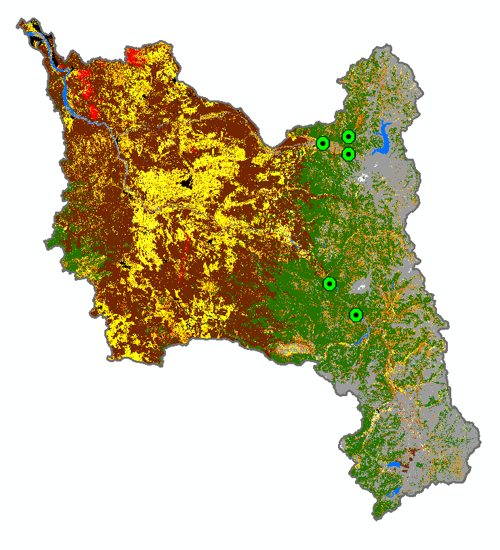
Biobio Green-blue corridor- case study for the co-design and implementation of NbS
Societal challenges
Nature-based solutions
Disaster risk
Forest fires
Reducing fire risk
Restoring riparian vegetation
Soil erosion
Ecological agriculture
Loss of wetland
River ecosystem fragmentation by dams
Sustainable crop production
River floods
Restoring wetlands
Restoring waterheads
Water scarcity
Socio-ecological conflicts
Improving filtration
Restoring native vegetation
Conserving natural infrastructure
Habitat fragmentation
Restoring and protecting remaining habitats
Connecting river ecosystems
Unsustainable agriculture
Loss of native forest
Conserving water resources
Over-explotation of forest resources
Connecting riparian vegetation
Sustainable forest production

